Slide 1
Design of a database for sample tracking
Simon Letarte, Ph. D.
Sr. Scientist
Analytical Sciences

Slide 2
Goals
Create a database for tracking the samples submitted to Analytical Sciences, document them and capture relevant metrics.
Reduce the amount of manual data entry.
Ensure data integrity and completeness.
Create a repository of all information related to all samples.

Slide 3
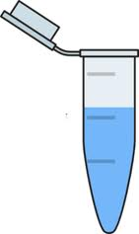

Current Tracking System
Calendar
email
Sample sheets
Sample sheets
Metrics
Sample sheets
Assay
Score Card
Data folder

Slide 4
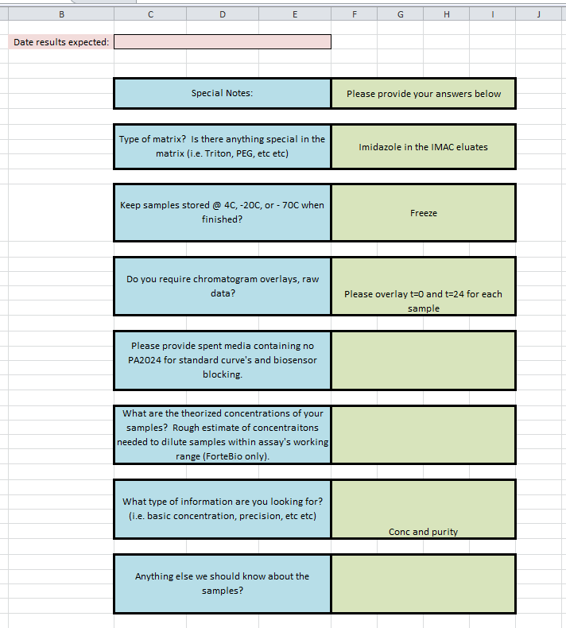
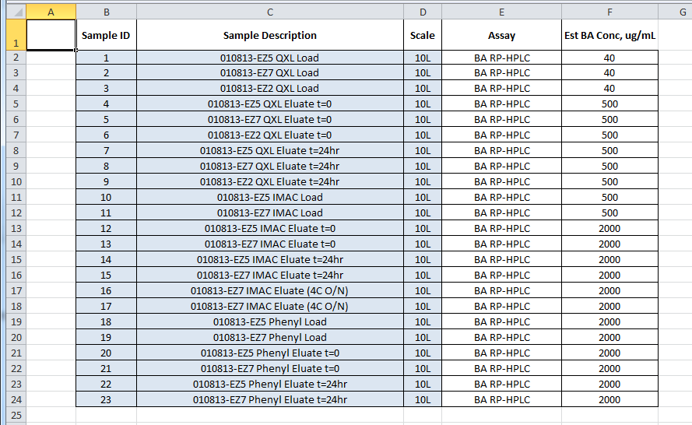
Sample Submission Sheet (s)

Slide 5
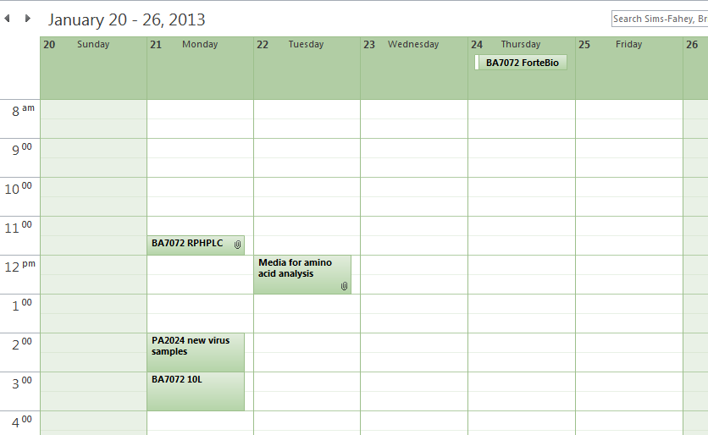
Shared Outlook Calendar

Slide 6
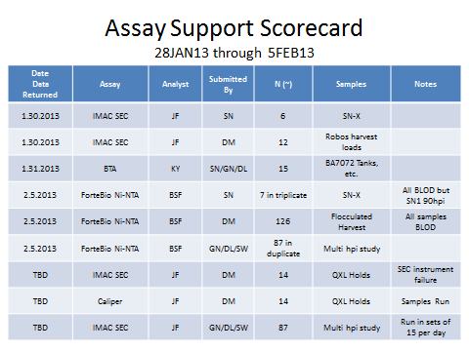
Assay Score Card.ppt

Slide 7
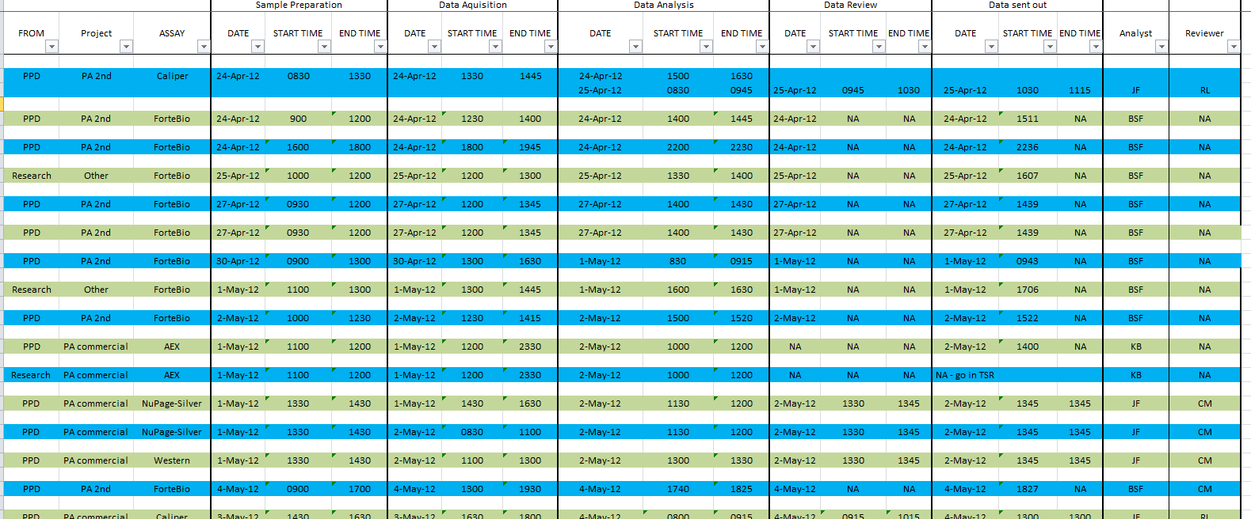
Metrics.xls

Slide 8
Problems with Current System
The system is powered by human intervention
Group Leader needs to create several reports by aggregating data from different sources, which is time consuming, inaccurate and error-prone.
Information submitted is often incomplete.
Analyst does not have easy access to the story behind the samples because information is scattered.

Slide 9
Proposed Sample Tracking System
Analysis Dispatch
email
Sample sheets
Sample sheets
Summary reports
Sample sheets
Database
Sample Queue
Results

Slide 10
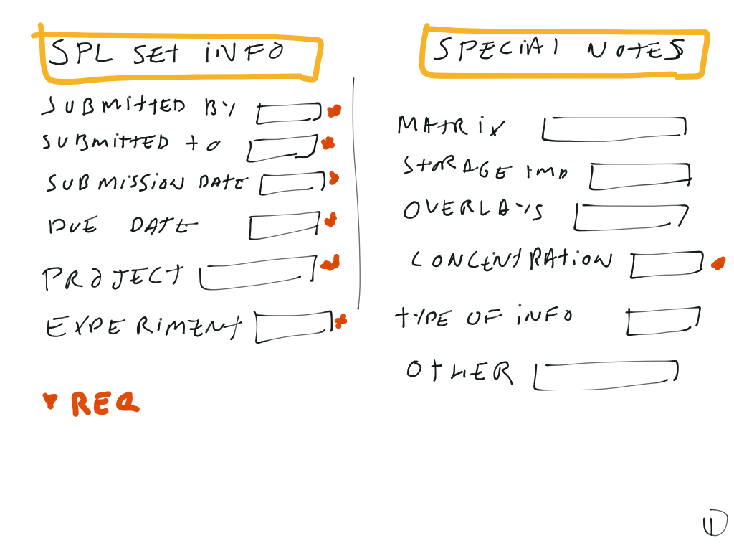

Slide 11
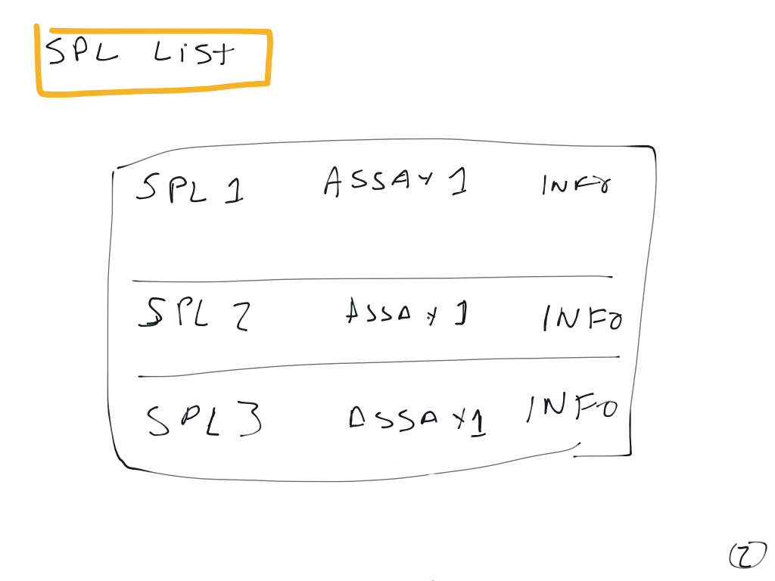

Slide 12
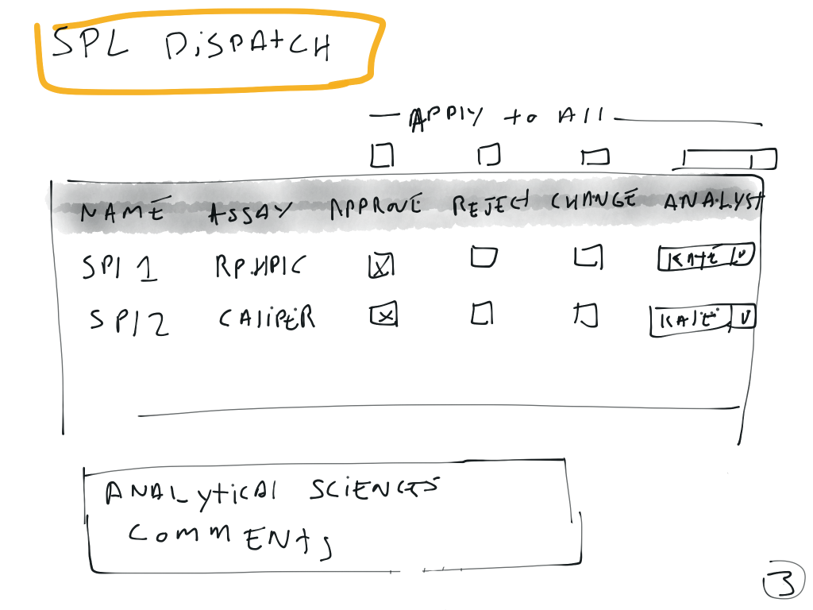

Slide 13
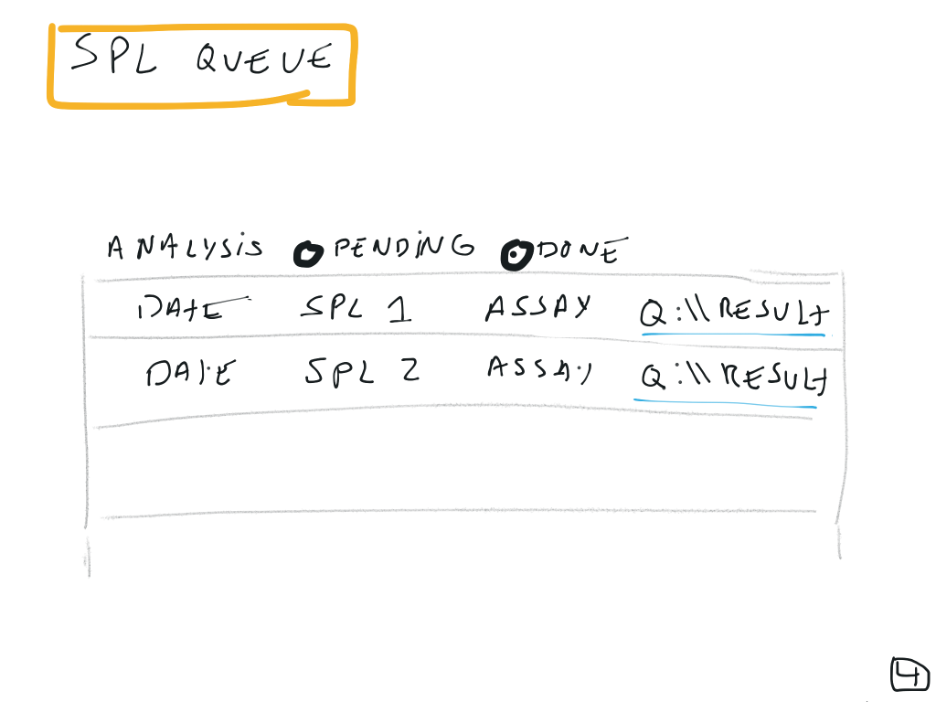

Slide 14
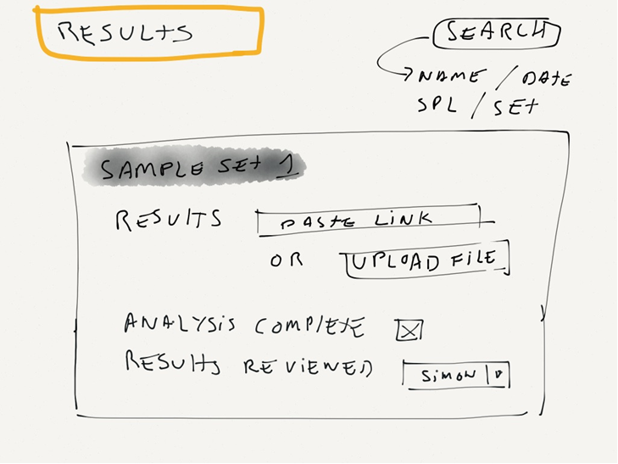

Slide 15
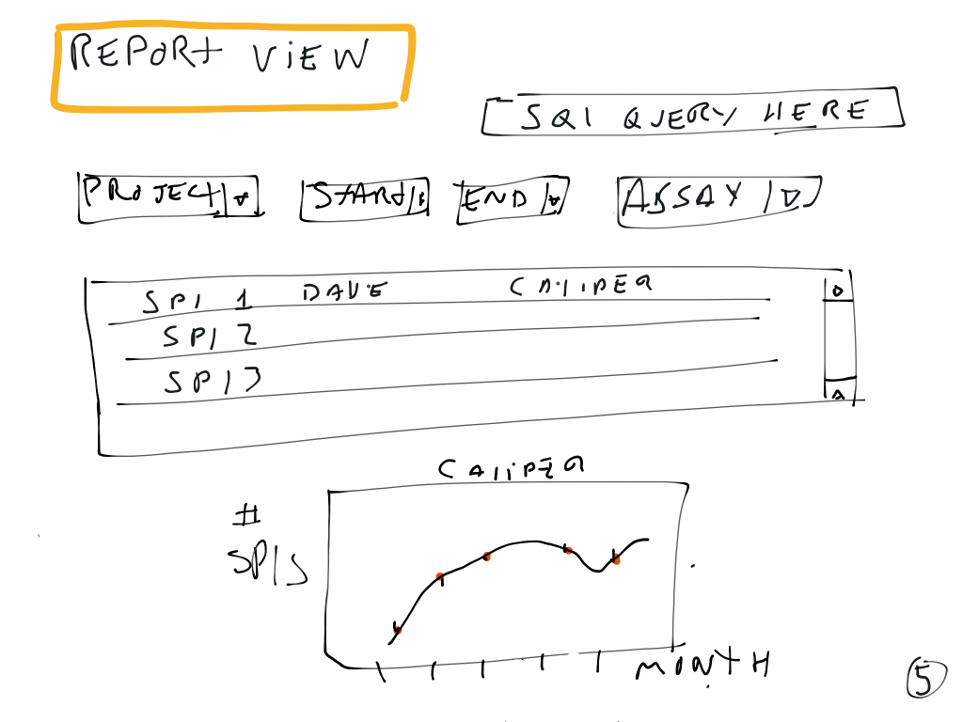

Slide 16
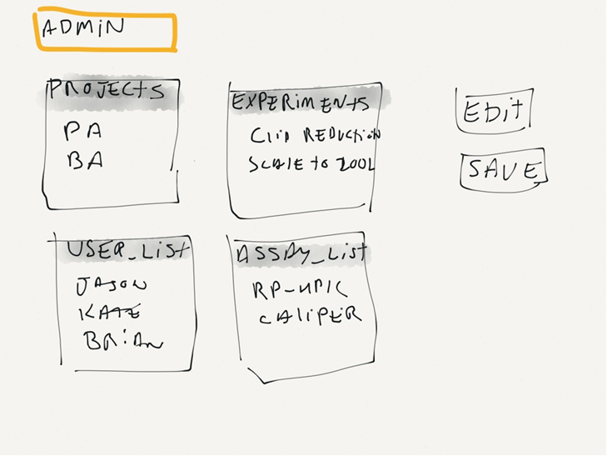

Slide 17
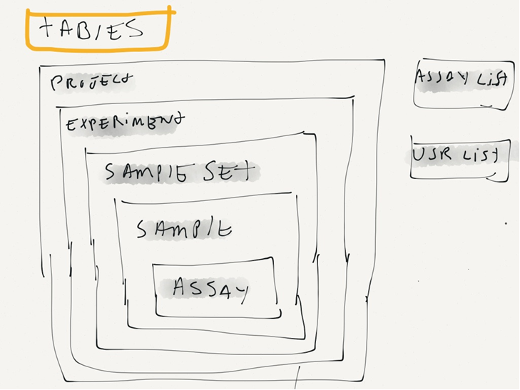

Slide 18
Benefits of this System
Ease of use
Robustness
Transparency
Complete picture in one place
Easily Accessible Metrics
Increase staffing and process efficiency
Easy to implement (~ 1 week of work)

Slide 19
Details to figure out
One assay per sample or sample can have multiple assay?
Upload the result files or just link to results folder?
Assay-specific info required fields?
Result tied to a sample or sample set?

Slide 20
Comments and Suggestions

